Slide 1
Small Teaching Part I: Roundtable Discussion on Teaching and Learning
ACERT Lunchtime Seminar: October 2nd, 2018, 12-2pm

Slide 3
Today’s Agenda
Introduction and Overview of Small Teaching – Paul McPherron
Making Connections – Sarah Ward
The Minutes Before Class – Stephanie Margolin
Giving Them a Say – David Petrain
The First 5 Minutes of Class – Jeff Allred
Space It Out – Shiao-Chuan Kung
Small Teaching Blog Posts and hypothes.is – Paul McPherron
Open discussion

Slide 4

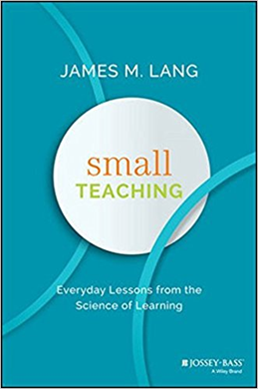
Small Teaching: James Lang

Slide 5
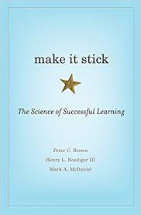

Two Perspectives on Change
We can’t fix higher education completely “because its foundation is flawed. And we can’t fix it piecemeal because it is a system. As with fundamental changes to conceptual systems in the history of science, the only solution is a radical transformation.” (Bloom, 2016)
“Much of what we’ve been doing as teachers and students isn’t serving us well, but some comparatively simple changes could make a big difference” Brown, Roediger, and McDaniel (2014)

Slide 6
Hitting Pause: Rice (2017)

Slide 7
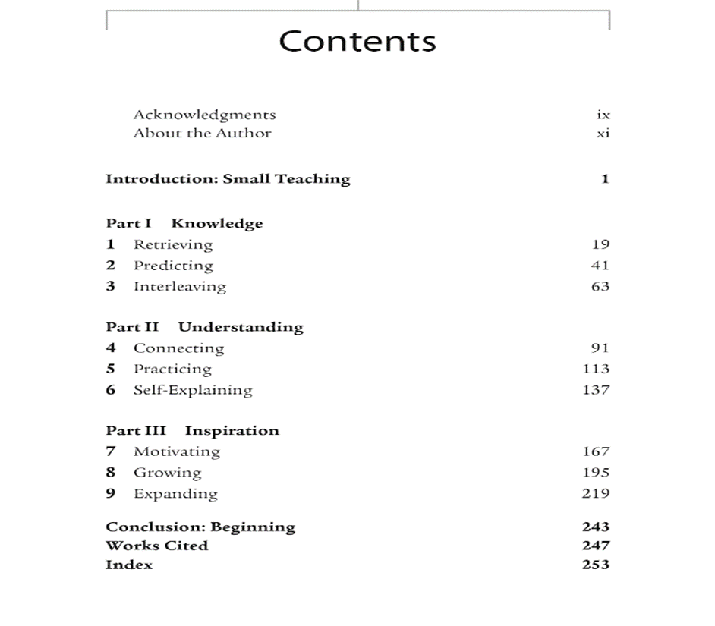


Slide 8
Small Teaching Innovations
Brief 5 minute classroom or online learning activities (e.g. predict what upcoming unit is about )
Limited and one-time interventions in a course (e.g. minute thesis)
Small modifications in course design or communication with students (e.g. building unit around central questions in your field)

Slide 9
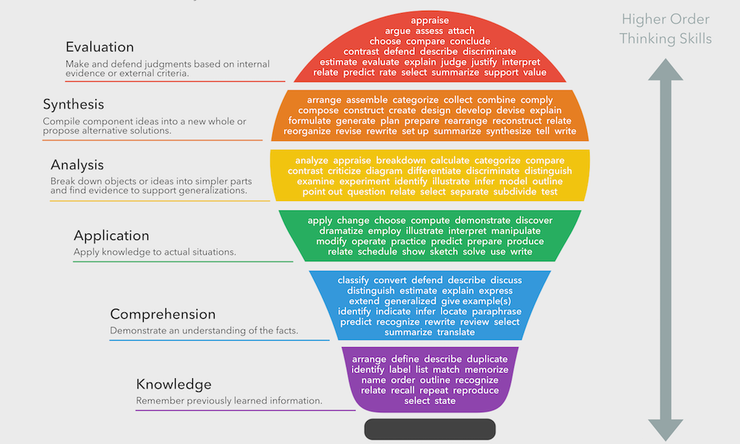
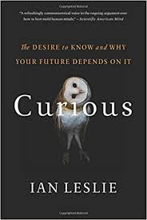
Part I: Knowledge
https://www.teachthought.com/learning/what-is-blooms-taxonomy-a-definition-for-teachers/
“Skills grow organically out of specific knowledge domains – this is to say, facts…The wider your knowledge, the more widely your intelligence can range and the more purchase it gets on new information”
Leslie (2015)

Slide 10
Thinking to Retrieve
Rice (2017)
“In long-term memory the limiting factor is not storage capacity, but rather the ability to find what you need when you need it. Long-term memory is rather like having a vast amount of closet space- it is easy to store many items, but it is difficult to retrieve the needed item in a timely fashion”
Michelle Miller (2011)

Slide 11
Retrieval: Summary of Learning Strategies
Low Utility:
Summarization
Highlighting
Re-reading
Keyword Mnemonics
Imagery
Moderate Utility:
Elaborative Interrogation
Interleaved Practice
Self-Explanation
High Utility:
Distributed Practice
Practice Testing

Slide 12
Small Teaching: Retrieval
Brief activities: Begin by asking students to “remind” you of previous content or summarize readings
Limited intervention: Close class by asking students to write one thing they would like to learn more about and why
Course modification: Mid-semester poll or recall activity; end of course concept map (e.g. finishing strong)

Slide 13
What is one question you have about retrieval or would like to learn more about and why?

Slide 14
Today’s Agenda
Introduction and Overview to Small Teaching – Paul McPherron
Making Connections – Sarah Ward
The Minutes Before Class – Stephanie Margolin
Giving Them a Say – David Petrain
The First 5 Minutes of Class – Jeff Allred
Space It Out – Shiao-Chuan Kung
Small Teaching Blog Posts and hypothes.is – Paul McPherron
Open discussion

Slide 15

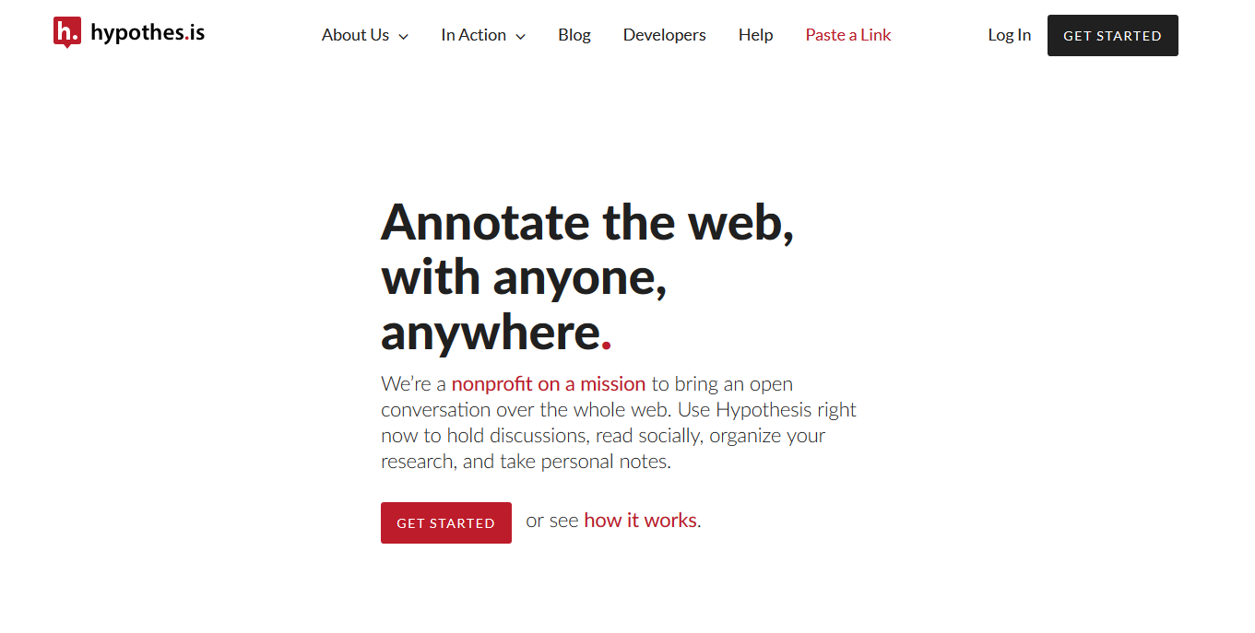
Small Teaching Blog Posts and hypothes.is
https://www.chronicle.com/specialreport/Small-Changes-in-Teaching/44
https://web.hypothes.is/

Slide 16
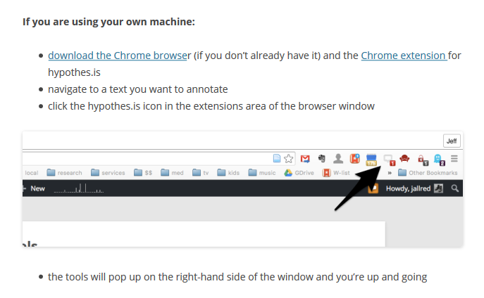
Allred ENG 720 hypothes.is instructions
https://allred720fa18.commons.gc.cuny.edu/2016/02/08/quick-follow-up-on-hypothes-is-evaluation/

Slide 17
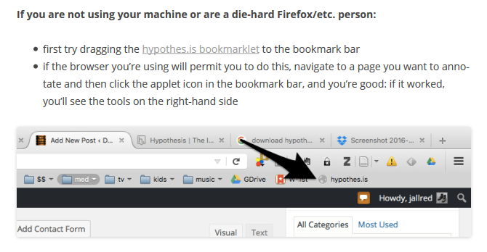
Allred ENG 720 hypothes.is instructions
https://allred720fa18.commons.gc.cuny.edu/2016/02/08/quick-follow-up-on-hypothes-is-evaluation/

Slide 18
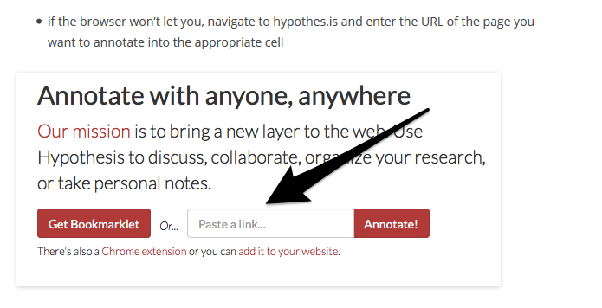
Allred ENG 720 hypothes.is instructions
https://allred720fa18.commons.gc.cuny.edu/2016/02/08/quick-follow-up-on-hypothes-is-evaluation/

Slide 19
Blog posts with “via links”
What Will Students Remember From Your Class in 20 Years? https://via.hypothes.is/https://www.chronicle.com/article/What-Will-Students-Remember/244633?cid=cp44
How much do you want your final to count?: https://via.hypothes.is/https://www.chronicle.com/article/How-Much-Do-You-Want-Your/242802?cid=cp44
Small Changes in Teaching: The Last Five Minutes of Class: https://via.hypothes.is/https://www.chronicle.com/article/Small-Changes-in-Teaching-The/235583?cid=cp44
Small Changes in Teaching: Making Connections: https://via.hypothes.is/https://www.chronicle.com/article/Small-Changes-in-Teaching-/235230?cid=cp44
Small Changes or Big Revolutions?: https://via.hypothes.is/https://www.chronicle.com/article/Small-Changes-or-Big/236839?cid=cp44
Small Changes in Teaching: The Minutes Before Class: https://via.hypothes.is/https://www.chronicle.com/article/Small-Changes-in-Teaching-The/234178?cid=cp44
Small Changes in Teaching: Giving Them a Say: https://via.hypothes.is/https://www.chronicle.com/article/Small-Changes-in-Teaching-/235918?cid=cp44
Small Changes in Teaching: The First Five Minutes of Class: https://via.hypothes.is/https://www.chronicle.com/article/Small-Changes-in-Teaching-The/234869?cid=cp44
Small Changes in Teaching: Space it Out: https://via.hypothes.is/https://www.chronicle.com/article/Small-Changes-in-Teaching-/236479?cid=cp44

Slide 20
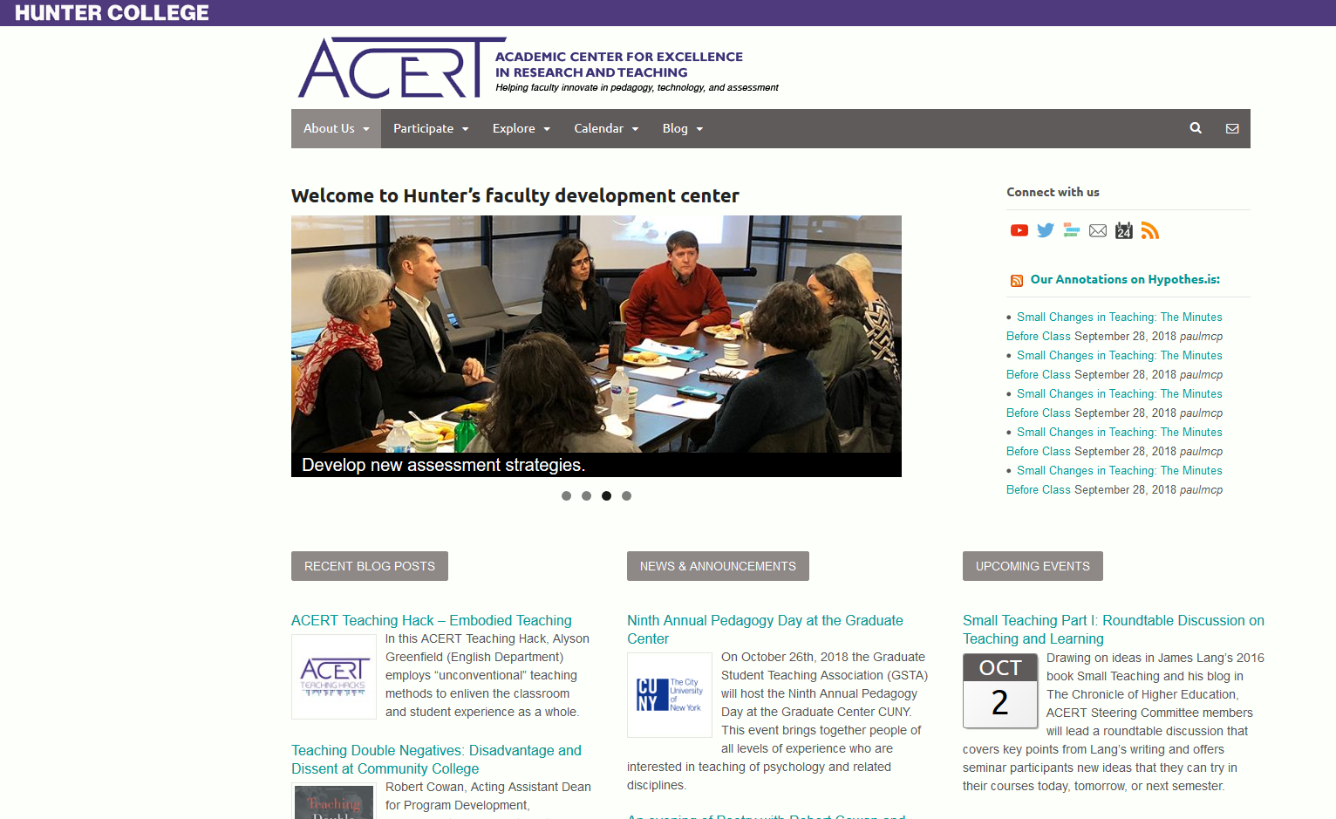
ACERT annotations on hypothes.is
Add all annotations to “Public” group
Tag all hypothes.is annotations with “ACERT”
Annotations will be listed on http://acert.hunter.cuny.edu/

Slide 21
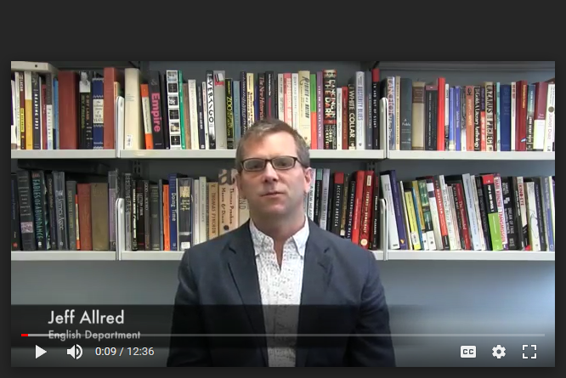
Hypothes.is Teaching Hack
http://acert.hunter.cuny.edu/blog/social-annotation-with-hypothesis/2018/10/02/

Slide 22
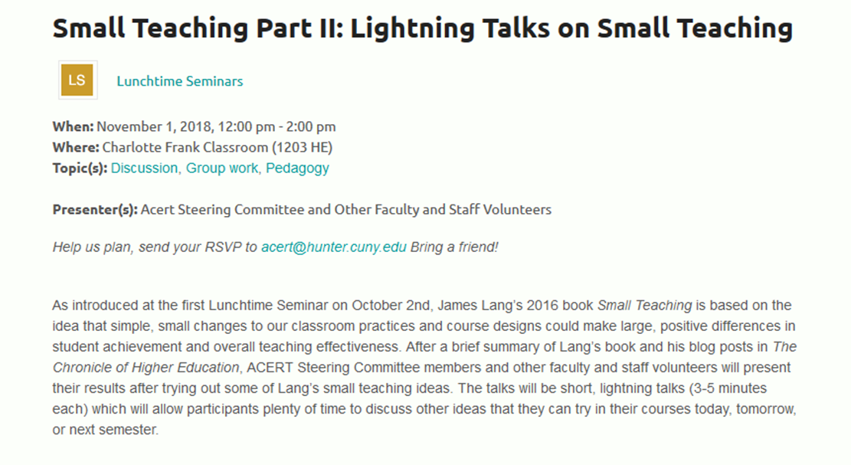
http://acert.hunter.cuny.edu/events/calendar/samll-teaching-part-2-f18/

Slide 23
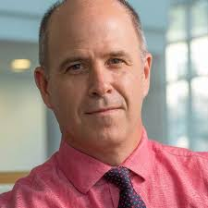
In closing: Small Teaching Groups
Finally, you have a teaching career ahead of you, however long or short that might be at this point in your life. You could continue to explore and experiment with small teaching strategies for another 20 to 30 years and probably still not exhaust the possibilities…If you have been inspired more deeply, perhaps you will gather a group of colleagues together to share your best ideas for small teaching and learn from one another in addition to learning from the literature on teaching and learning in education. The prospects can be as wide or narrow as you wish.
Most important, you have class tomorrow morning.
How will you begin?

