Slide 1
Assessment during the Pandemic: What is Different, What Remains the Same?
ACERT Thoughtful Thursday | October 22nd, 2020
Joel D. Bloom (Office of Assessment)
Gina Riley (Special Education, SOE)
Shiao-Chuan Kung (Ctr. for Online Learning)

Slide 2
What We’ll Be Talking About Today:
Difficulties presented by the emergency shift to online instruction, and then the more considered shift for 2020-2021)
Opportunities presented by the online instructional mode
Some specific thoughts and examples about assessing student learning online
Some specific tools for assessing student learning online
What else you got?

Slide 3
We Know This Year is Hard But We Still Need to Assess

Slide 4
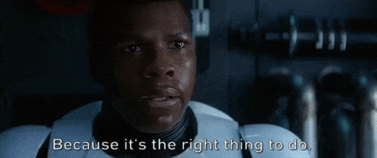
We Still Need to Assess Because:
Middle States Says So
CUNY Says So
We Care Whether Our Students Are Learning

Slide 5
We Know What’s Hard About Online Teaching
Uncompensated Labor
Unfamiliar Hi-Tech Terrain
Too-Familiar Working-From-Home Terrain
Sense of Distance/Alienation
Anxiety & Depression
Worries about COVID
Hard seeing students dealing with all these stressors
Hard to fit in everything you usually teach
What else?

Slide 6
But There are Some Good Points Too
Zero Commute Time!

Slide 7
More Good Points
Easier Dress Code

Slide 8
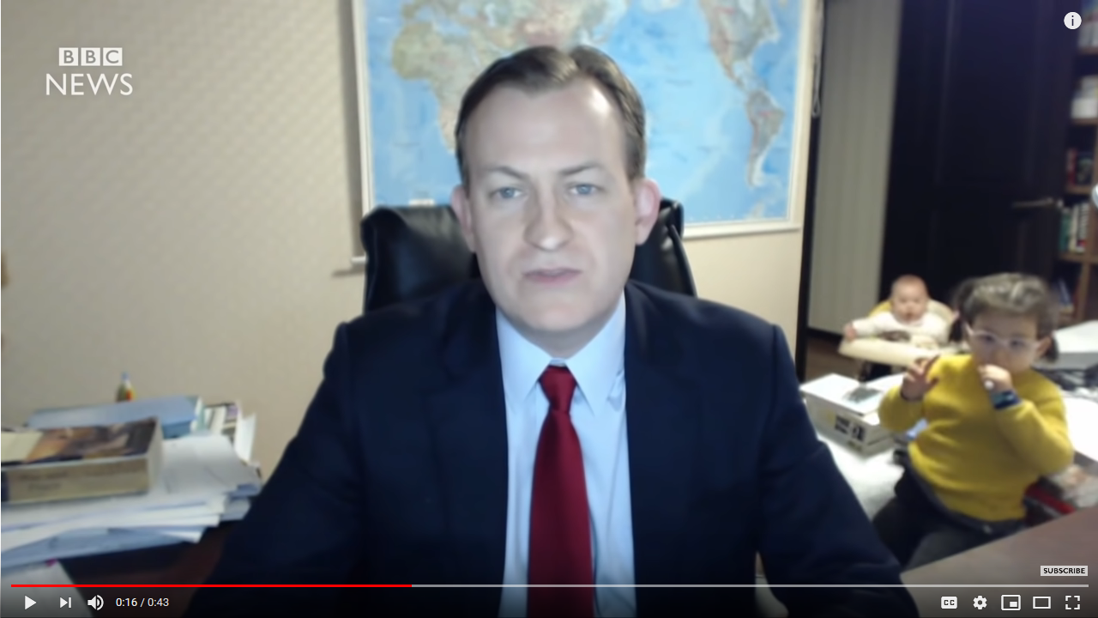
More Good Points
Getting to see everyone’s cute pets and kids

Slide 9
But Back to Assessment
What hasn’t Changed?
We still teach, and expect our students to learn stuff.
We still call the stuff we want our students to learn “learning outcomes.”
We still provide our students with a combination of different types of materials (readings, videos, lectures, discussions, group projects, etc.) that we hope will get the materials through to them.
We sill give our students opportunities to demonstrate to us that they have learned all that stuff (quizzes, tests, papers, discussion boards, in-class discussions, oral presentations, exams, etc.)
So in most ways that matter for assessment, nothing substantive has changed.

Slide 10
OK, So What Has Changed for Assessment?
If anything, it’s easier than before to collect student “artifacts” to assess.
There are a whole other range of student “artifacts” we can look at for assessment purposes.
We can use all kinds of electronic meta-data as metrics too!
This whole-sale shift in mode of instruction provides us with an opportunity to re-think our core values and priorities.

Slide 11
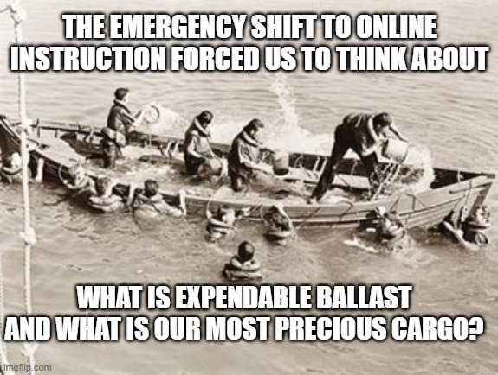
What Do We Really Care About Students Learning in Our Courses? In Our Majors?
There has never been a better time to re-think our Course Learning Outcomes (CLOs) & Program Learning Outcomes (PLOs)

Slide 12
Questions, Comments, Contact
Joel D. Bloom
joel.bloom@hunter.cuny.edu
Gina Riley
griley@hunter.cuny.edu
Shio-Shuan Kung
skung@hunter.cuny.edu

