Slide 1
ACERT Book Talk Unschooling: Exploring Learning Beyond the Classroom
Gina Riley, Ph.D.
CUNY Hunter College

Slide 2
We’ve come a long way…
Interest in home learning has doubled during the pandemic.
10% of American families are choosing to homeschool this year, up from 5% one year ago (Gallup, 2020).
This percentage does not count the number of families schooling from home or remote schooling with curriculum coming from the district, or home learning within a pandemic pod.
Interest is increasing day by day, as the National Home School Association reports receiving 3400 calls per day, as opposed to the 5 or 10 they generally get about homeschooling.
Of course, we will see whether this number changes after the pandemic, but one thing is clear: More families are pursuing educational alternatives than ever before.
Unschooling as a choice, just like public, private, or homeschooling.

Slide 3
Difference between Homeschooling and Unschooling
Unschooling is often considered to be a branch of homeschooling.
While other homeschoolers may do “school at home” and follow a set curriculum, unschoolers learn primarily through everyday life experiences - experiences that they choose and that therefore automatically match their abilities, interests, and learning styles (Wheatley, 2009).
In unschooling, there are no grades or tests. Assessment is authentic and intrinsic.
Approximately 20 % of homeschoolers consider themselves unschoolers, and that number is growing every day.
Most unschoolers start off as traditional homeschoolers, then loosen curriculum expectations as they see how much their child is learning and growing on their own.

Slide 4
Historical Perspectives
Hunter-Gatherer Cultures - learning through cultural transmission
Rousseau (1712 – 1788) learning from the natural world, education as natural, simple and unstructured
John Dewey (1859 – 1952) focus on having individuals be socially engaged, democratic citizens
“I believe that education, therefore, is a process of living, and not preparation for future living”
A.S. Neill (1883 – 1973) Summerhill, boarding school focused on freedom and autonomy for all students.
Ivan Illich (1926 – 2002) “Deschooling Society” - critique of compulsory education
John Holt (1923 – 1985) “How Children Fail” (1964), “How Children Learn” (1967) Father of Unschooling
John Taylor Gatto (1935 – 2018) “Dumbing Us Down” (1992) and The Underground History of American Education” (2001)
Peter Gray (1946 – present) “Free to Learn” (2013)

Slide 5
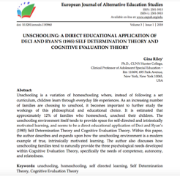
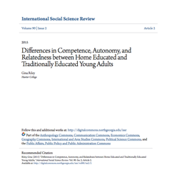
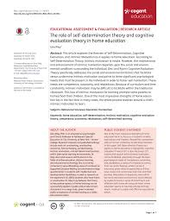
Theoretical Perspectives
Self Determination Theory/Cognitive Evaluation Theory (Deci & Ryan, 1985)
**Focus on Intrinsic Motivation and the facilitation of competence, autonomy, and relatedness.
Gardner (1991) Theory of Multiple Intelligences

Slide 6
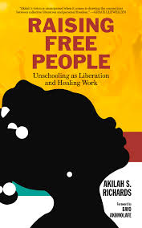
Growth of Unschooling
Demographics: Once the realm of liberal white two parent families, the face of unschooling has changed dramatically.
Increase especially in Black and Hispanic families (due to schools not meeting the needs of their children, as well as the predominantly Eurocentric curriculum taught in most schools)
Increase in students of lower SES unschooling
Increase in students with special needs unschooling
Increase in students who identify as LGBTQ unschooling

Slide 7
Paths to Unschooling
Most individuals come to unschooling after a period of homeschooling (and previously, public or private schooling)
Concept of ”Deschooling” (especially on the part of the parent or guardian)
Natural family living, books, conferences, speakers, TED talks
As a result of knowing other unschooling families

Slide 8
Subject Based Learning and Criticisms
A major criticism of unschooling comes from the notion that unschooled students will have gaps in their education as a result of not having a “well rounded, curriculum based education”.
***Just as schooled students have gaps in learning, unschooled students will too.
“In my teens I used to worry that I had “gaps” when compared to schooled peers, but the older I got the more apparent it became just how different everyone’s skills were. I realized that I was better at some things than some people, and other people were better at other things. I knew more about some subjects, and less about others, just like all of my friends, whether schooled, homeschooled, or unschooled (Desmaris, 2020)
***One of the most widely known benefit of unschooling: Individuals learn HOW to learn, and live a life of learning that is completely generalizable (Riley & Gray, 2013)

Slide 9
Challenges of Unschooling (Gray & Riley, 2013)
Gray and Riley’s (2013) study was the first large scale, international study of 232 unschooling families. Reviewed demographic data on unschooling, reasons for unschooling, and the benefits and challenges of unschooling.
43.5% respondents: feeling of social stigma and pressure based on the choice to unschool
42% getting rid of culturally ingrained thoughts re: the nature of teaching and learning
Time, career, and income effects
Legal issues surrounding unschooling

Slide 10
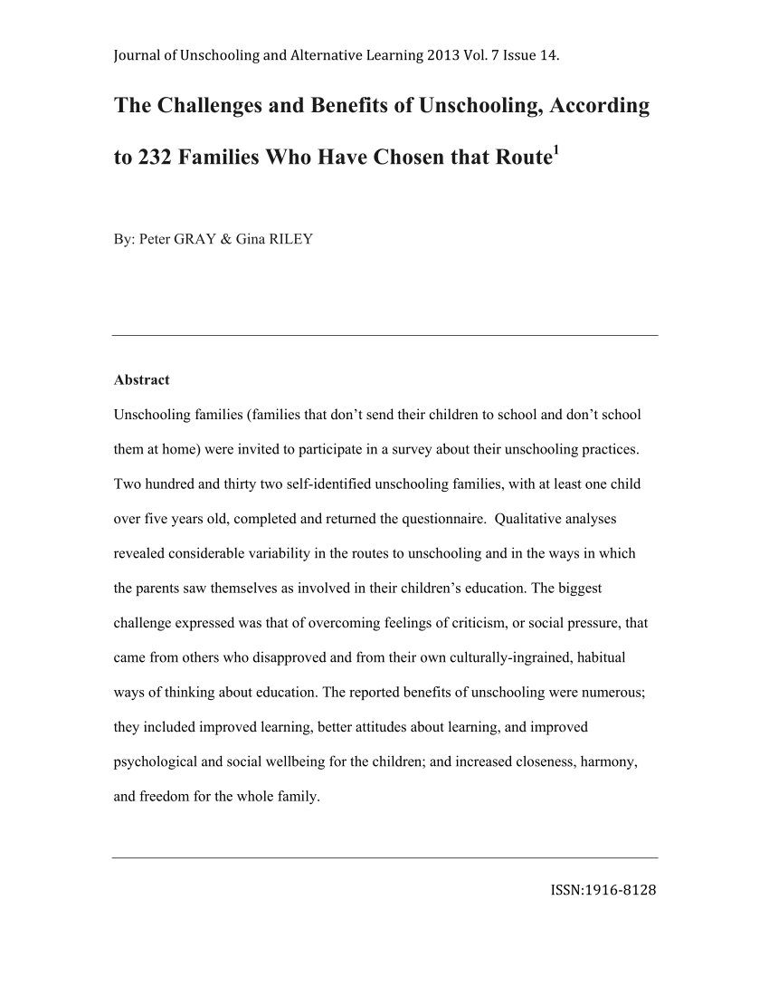
Benefits of Unschooling (Gray & Riley, 2013)
57.3% - Increased Student Learning
52% - Social Emotional Benefits
57% mentioned an increase in Positive Family Relationships
36% reported Family and Individual Freedom of Schedule

Slide 11
Adult Unschooler Outcomes (Gray & Riley, 2015; Riley & Gray, 2015)
69% reported a good social life (specifically mentioned age mixing benefits and positive social interactions)
77% Time to pursue one’s interests
75% Freedom and independence
75% Increased self direction and intrinsic motivation**
Also: Increased learning, smoother transition to adulthood
37% reported no disadvantages
3 out of 75 reported more negative experiences (in all cases, parent had mental health issues…2/3 saw benefits in the unschooling experience overall)

Slide 12
Adult Outcomes Continued
83% of respondents pursued higher education
**Different paths to college acceptance
All respondents were employed (except for those who were full time students or caregivers for young children)
78% completely financially independent

Slide 13
From one unschooler….
The biggest advantage of unschooling was that it smoothed the transition to adulthood
instead of all of a sudden being thrown out into the real world of college or career at age
18. I was able to begin exploring these things at a young age and at my own pace. At 15
I was able to take a college class, because I was interested, and see what college was like.
At 16 I was able to start working a part time job, and slowly work more and more. I was
able to enroll full time in college in what would have been my senior year of high school.
I didn’t have to wait…unschooling gave me the immediate benefit of time and space to
explore my interests and ask myself questions such as “What kind of person am I?” and
“Who do I want to be?”, and then work to make those the same (Gray & Riley, 2015).

Slide 14
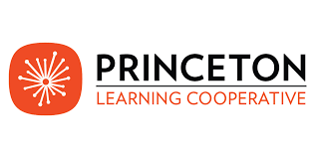
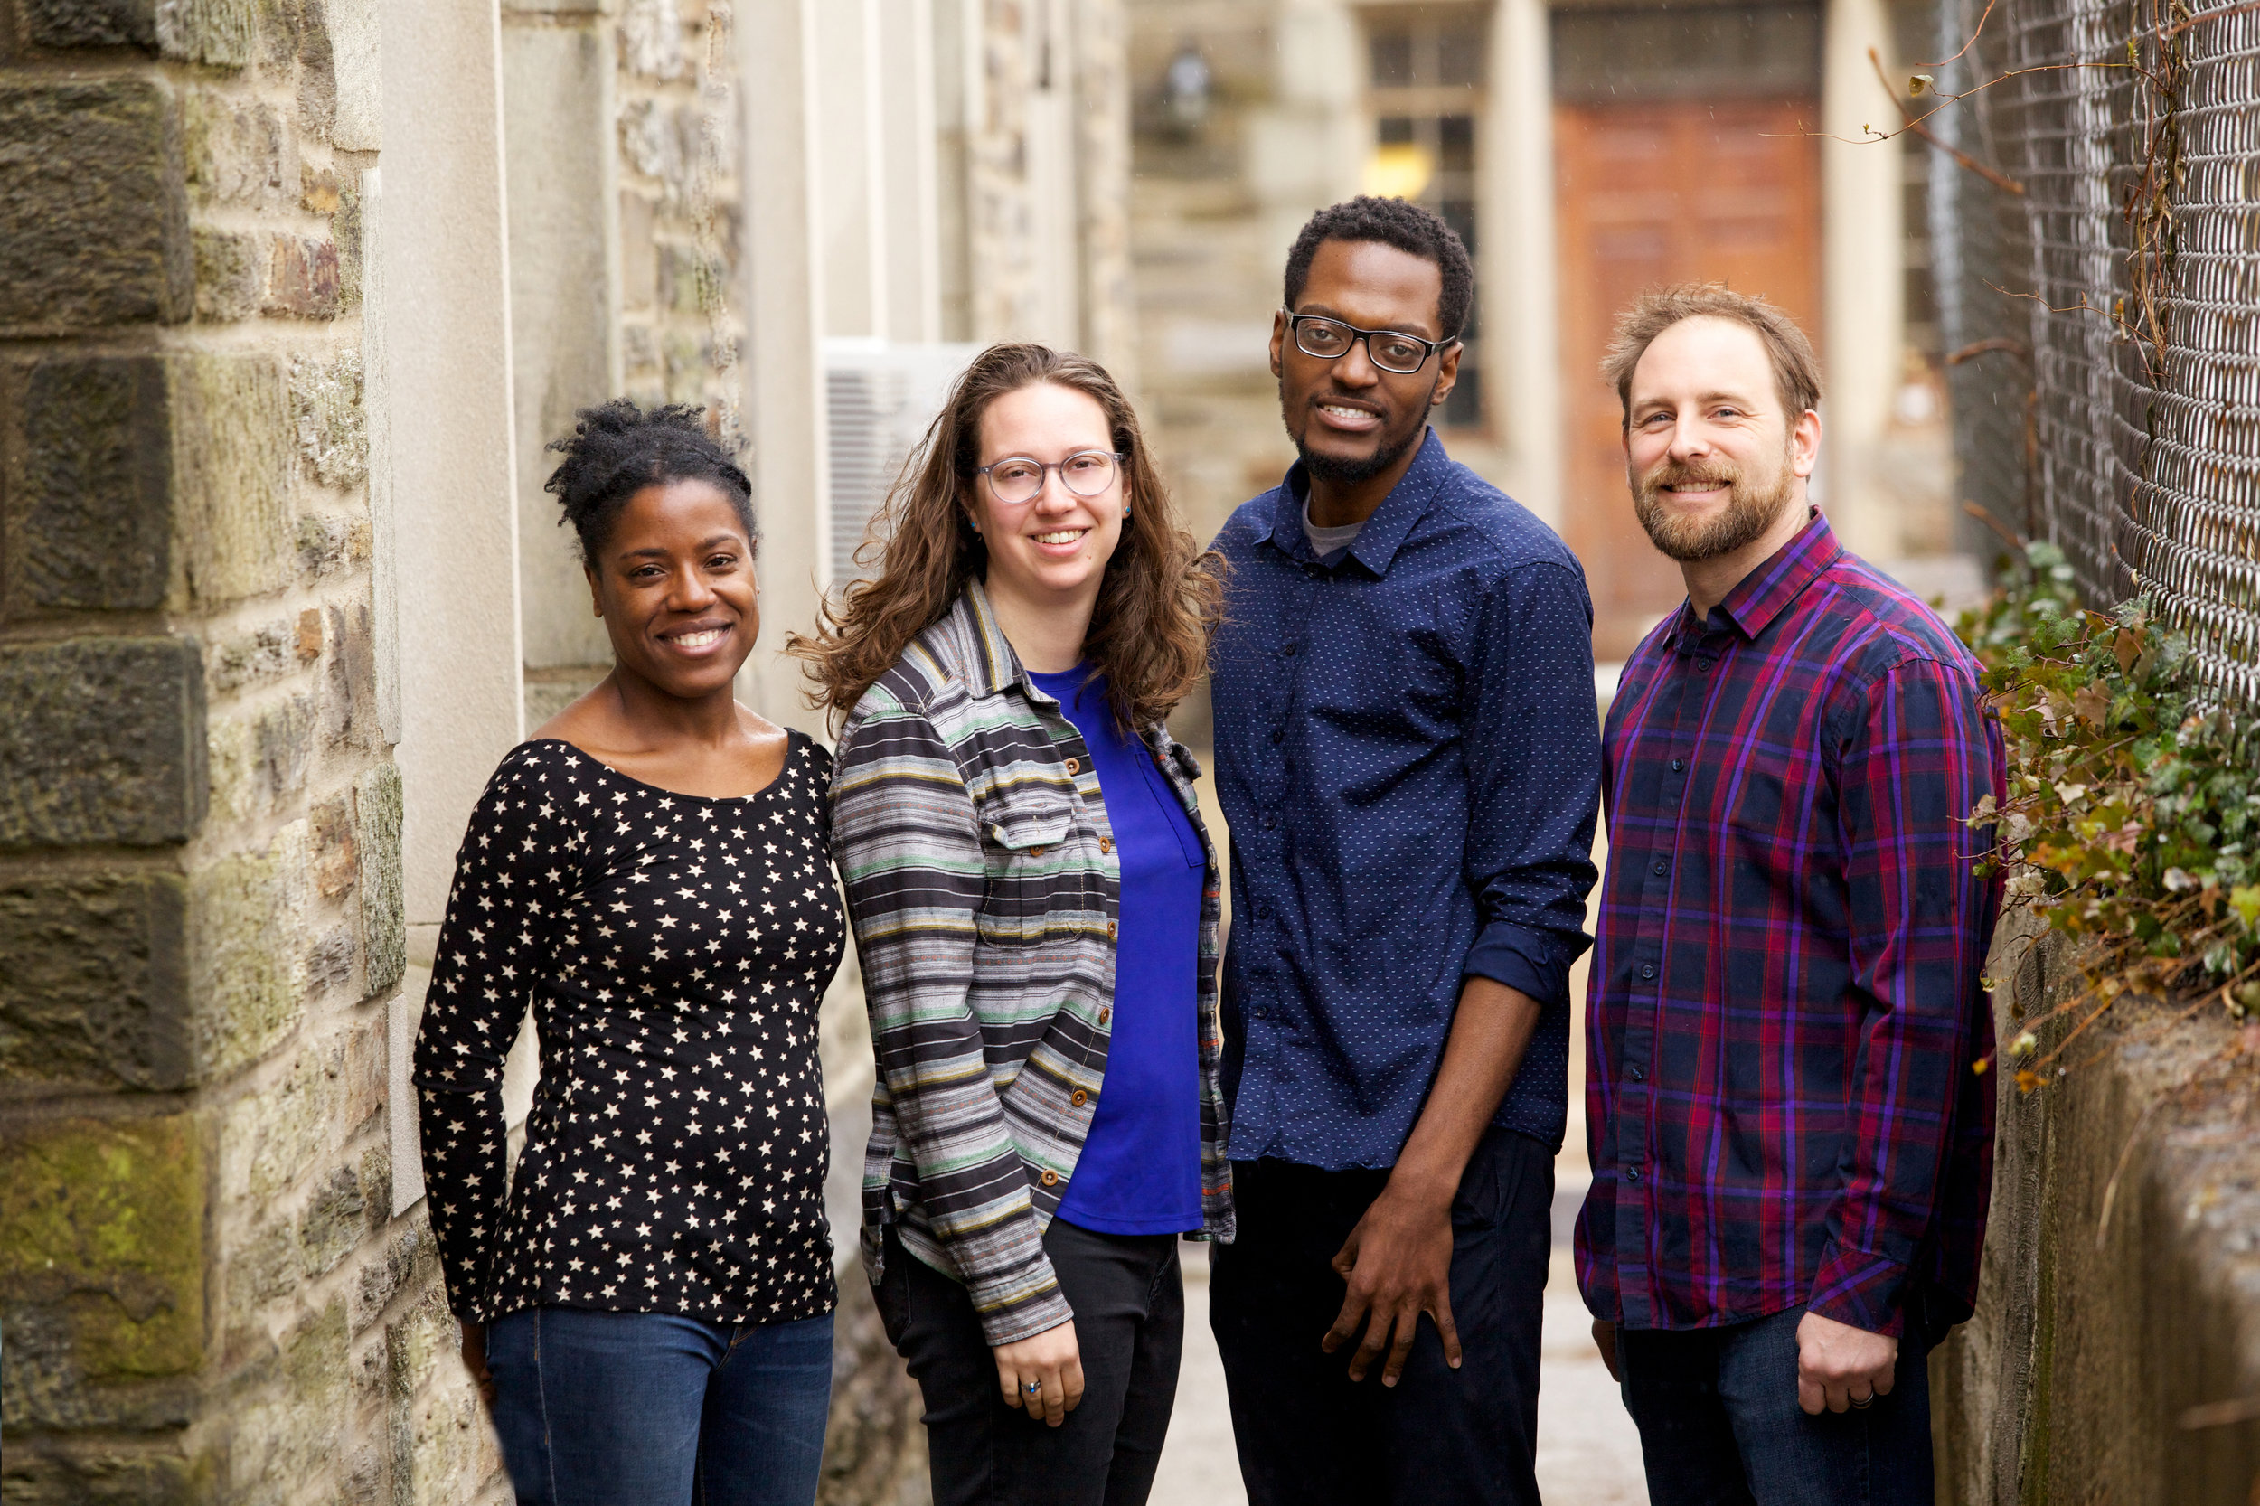
Branches of Unschooling
Worldschooling
Outdoor schooling**
Unschooling Co-Ops and Self Directed Learning Centers (North Star in Massachusetts, Princeton Cooperative in New Jersey, Natural Creativity Center in Pennsylvania, Liberated Learners all across the United States)

Slide 15
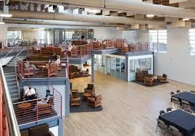
Public and Private School Extensions
National Opt Out Movement
Democratic or Sudbury Schooling
Monument Mountain Regional High School
David Lane: ”One Period a Day”
High Tech High School

Slide 16
University as Unschooling**
Independent study and independent projects
Generalizable Curriculum
Qualitatively assessed projects
Self-directed, Socratic Seminars
”Choose your own adventure” assignments
Civic and Community Engagement (even remotely!)
Internships/Apprenticeships
Spending days doing what we love

Slide 17
Q & A Giveaway!

Slide 18
Contact and References
References and Articles upon request
griley@hunter.cuny.edu

